Slide 1

Joshua J. Drake First Annual Breakpoint October 17th 2012
Tackling the Android Challenge
Notes:
EHLO

Slide 2
Overview
About Josh
Goals
Survey
Background
Ecosystem
Patching
Disclosure
Attack Surface
Tools
Exploitation
Hardening
Recommendations
Conclusions
Notes:
This is what we’re going to cover in the next 40 minutes or so…
I won’t be covering Android Application security topics like Intents, Content Providers, Broadcast Receivers, and such.
Still, If you have a question about that stuff, I’ll do my best to answer them.

Slide 3

About the Presenter
Joshua J. Drake, aka jduck
Senior Research Scientist with Accuvant LABS
Former Lead Exploit Developer
Researching Linux security since 1994 (1.1.59)
Researching Android security since Droid 1 (2009)
Consulted for a major Android device OEM
Presented a working Android ICS 4.0.1 browser exploit at BlackHat USA 2012
Notes:
Binary/Source Audit, Reverse Engineering
Vulnerability Discovery & Exploitation
Currently focused heavily on Android research

Slide 4
Goals
Improve Android security
Improve security awareness
Provide motivation ;-)
Enable other researchers to do their thing
Summarize information from many sources
Improve the tool-chain
Notes:
Improve security awareness
Point out weaknesses when discovered
Spread the word about weaknesses
Provide “motivation” to parties involved in the ecosystem

Slide 5

Survey
Notes:
I’d like to ask a few questions. Please don’t be shy, please answer.
Your answers won’t be shared outside this room, but they will guide how I proceed with the rest of the talk.
It will also help me spot like-minded people to chat up later ☺
How many people here don’t know what Android is?
How many people have at least one Android device?
How many people have more than one?
More than 5? 10? …?
If you have one with you, keep it handy. I’ll tell you about an Easter egg in a bit!

Slide 6
Background
Notes:
So let’s go over some Android background…
Skip slides based on survey results

Slide 7
Introduction
Smartphone operating system
Open Source (somewhat)
Linux based
Notes:
Android is currently the most popular smartphone operating system on the planet.
Although it is often touted as being open source, this is not entirely true. More on that in a bit.
It’s based on a modified version of the Linux kernel.

Slide 8
Early History
Founded in 2003
Acquired by Google in 2005
Released publicly in 2008 (HTC G1/Dream)
~ 30 releases so far
http://en.wikipedia.org/wiki/Android_version_history
http://socialcompare.com/en/comparison/android-versions-comparison
Notes:
Founded by Andy Rubin, Rich Miner, Nick Sears, and Chris White

Slide 9
Version History
Version | Date | Code name
1.0 | Sep 23, 2008 | Apple Pie?
1.1 | Feb 9, 2009 | Banana Bread?
1.5 | Apr 30, 2009 | Cupcake
1.6 | Sep 15, 2009 | Donut
2.0 | Oct 26, 2009 | Eclair
2.0.1 | Dec 3, 2009 | Eclair
2.1 | Jan 12, 2010 | Eclair
2.2 | May 20, 2010 | Froyo
2.2.1 | Jan 18, 2011 | Froyo
2.2.2 | Jan 22, 2011 | Froyo
2.2.3 | Nov 21, 2011 | Froyo
2.3 | Dec 6, 2010 | Gingerbread
2.3.3 | Feb 9, 2011 | Gingerbread
2.3.4 | Apr 28, 2011 | Gingerbread
2.3.5 | Jul 25, 2011 | Gingerbread
Version | Date | Code name
2.3.6 | Sep 2, 2011 | Gingerbread
2.3.7 | Sep 21, 2011 | Gingerbread
3.0 | Feb 22, 2011 | Honeycomb
3.1 | May 10, 2011 | Honeycomb
3.2 | Jul 15, 2011 | Honeycomb
3.2.1 | Sep 20, 2011 | Honeycomb
3.2.2 | Aug 30, 2011 | Honeycomb
3.2.4 | Dec 2011 | Honeycomb
3.2.6 | Feb 2012 | Honeycomb
4.0.1 | Oct 19, 2011 | Ice Cream Sandwich
4.0.2 | Nov 28, 2011 | Ice Cream Sandwich
4.0.3 | Dec 16, 2011 | Ice Cream Sandwich
4.0.4 | Mar 29, 2012 | Ice Cream Sandwich
4.1.1 | Jul 9, 2012 | Jelly Bean
4.1.2 | Oct 9, 2012 | Jelly Bean
Notes:
This information is from Wikipedia - http://en.wikipedia.org/wiki/Android_version_history
Another great reference is - http://www.theverge.com/2011/12/7/2585779/android-history
I’m not going to read through all this, but there are couple of important things to draw from this.
First, although Android is soon celebrating its fifth birthday, it’s really only been available for 4 years.
Second, the current version is 4.1.2 – Jelly Bean. It represents the culmination of development since inception.

Slide 10
Fun Fact I
Releases are named alphabetically after sweets!
Cupcake
Donut
Eclair
Froyo
Gingerbread
Honeycomb
Ice Cream Sandwich
Jelly Bean
Key Lime Pie
L??? Lollipop?
M??? Marble Cake?
N??? Nougat?
Notes:
Some speculative names for the future, we’ll see…

Slide 11
Supported Architectures
Android supports at least 4 architectures
ARM
The Lion’s share of devices out there…
x86
Google TV devices, tablets, phones
MIPS
PowerPC
Really anything Linux will run on…
Notes:
Raise your hand if you have a MIPS, PowerPC or SuperH device…

Slide 12
Fun Fact II
There’s an Easter egg –
Settings -> About Phone
Quickly tap “Android version” 4-5 times
Some are interactive (try long press, etc)
DEMO
* Doesn’t appear to work on HTC devices…
Y U NO FUN HTC?!
Notes:
If you still have an Android device handy, feel free to try it with me.

Slide 13
Ecosystem
It’s complicated…

Slide 14
Ecosystem
Understanding the Ecosystem is important
Provides perspective
Good to know who is responsible for what
Makes the complexities involved evident
Put yourself in their shoes…
Helps you put your palm on your face

Slide 15
Ecosystem: Groups
Six main groups
Google
Hardware fabricators
Original Equipment Manufacturers (OEMs)
Carriers
Developers
Users
All inter-dependent to varying degrees…

Slide 16
Ecosystem: Groups
Six main groups
Google
Hardware fabricators
Original Equipment Manufacturers (OEMs)
Carriers
Developers
Users
All inter-dependent to varying degrees…
Notes:
Google
Provides community leadership due to licensing and CTS (more on CTS in a bit)
Open source, but …
Secret in-house dev and partnerships
Releases source in batches, not live commits

Slide 17
Ecosystem: Groups
Six main groups
Google
Hardware fabricators
Original Equipment Manufacturers (OEMs)
Carriers
Developers
Users
All inter-dependent to varying degrees…
Notes:
Hardware fabs
When I talk about this group, I mean the hardware platform building blocks. That is, processors, sensors, etc. The chips
Processors – Systems-on-Chip
ARM doesn’t make chips, only designs
TI OMAP, Nvidia Tegra, Samsung Exynos, Qualcomm MSMxxxxx
Various other peripherals
Radios, LCDs, sensors, gps, camera, etc
All hardware components need support in Linux
drivers, etc

Slide 18
Ecosystem: Groups
Six main groups
Google
Hardware fabricators
Original Equipment Manufacturers (OEMs)
Carriers
Developers
Users
All inter-dependent to varying degrees…
Notes:
OEMs
Make devices for consumers
Attempt to customize the OS for brand loyalty or differentiation
May introduce security issues in the process
Handle integration with hardware platform
Plenty of proprietary blobs around

Slide 19
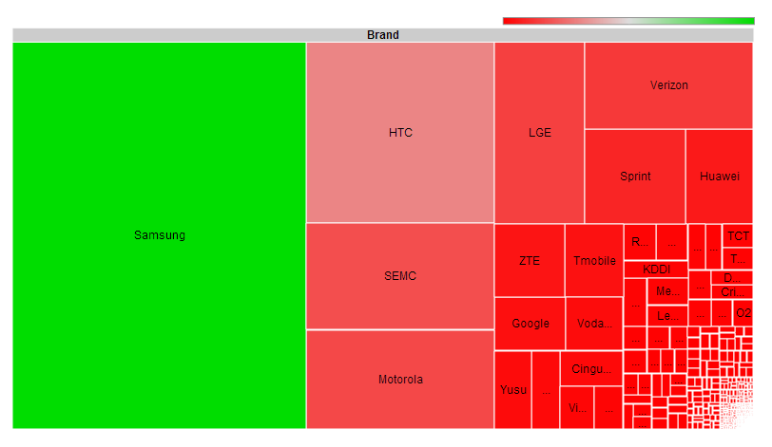
Ecosystem: OEMs
http://opensignal.com/reports/fragmentation.php

Slide 20
Ecosystem: Groups
Six main groups
Google
Hardware fabricators
Original Equipment Manufacturers (OEMs)
Carriers
Developers
Users
All inter-dependent to varying degrees…
Notes:
Carriers
Provide mobile voice and data services
Vodaphone, AT&T, etc
Add custom services (backup, voicemail, etc)
Add paid bloatware to devices (preloaded system apps)

Slide 21
Ecosystem: Groups
Six main groups
Google
Hardware fabricators
Original Equipment Manufacturers (OEMs)
Carriers
Developers
Users
All inter-dependent to varying degrees…
Notes:
Developers
Basically 3 groups
OS developers
Kernel developers
App Developers
Android has more OS and kernel developers than Apple, but Apple has more App developers

Slide 22
Ecosystem: Groups
Six main groups
Google
Hardware fabricators
Original Equipment Manufacturers (OEMs)
Carriers
Developers
Users
All inter-dependent to varying degrees…
Notes:
Users
Want a single multi-function device
PDA Functions, Camera, Internet terminal
Play games while waiting in line
Spend a lot of money on their devices
New device: 300 up front, 2 yr contract at $100/mo -> ~2500 over 2yrs

Slide 23
Open Handset Alliance
OHA
Founded 2007
Mission: increased openness
Compared to mobile ecosystem before Android?
Members Android builds must be “Android Compatible”
Currently includes most vendors working with Android
Notes:
Founded in 2007
The alliance states they are for increased openness
Members are not allowed to released Android builds that are not “Android Compatible”
(more about this in a bit)
The open handset alliance currently includes pretty much all of the major Android vendors

Slide 24
Ecosystem: Summary
Massive cross-organizational Bureaucracy
Everyone working with different goals
Some goals are competing
Notes:
I’m frankly amazed that they’ve gotten this far.

Slide 25
Ecosystem: Summary
Provides a rich area for security research
Implicit trust between groups
Source code complexities
Creates “half-day” exploit risk
Ex: Bugs fixed in Chrome but not Android
Lengthens patch cycle
Leaves end-users unprotected

Slide 26
Patching

Slide 27
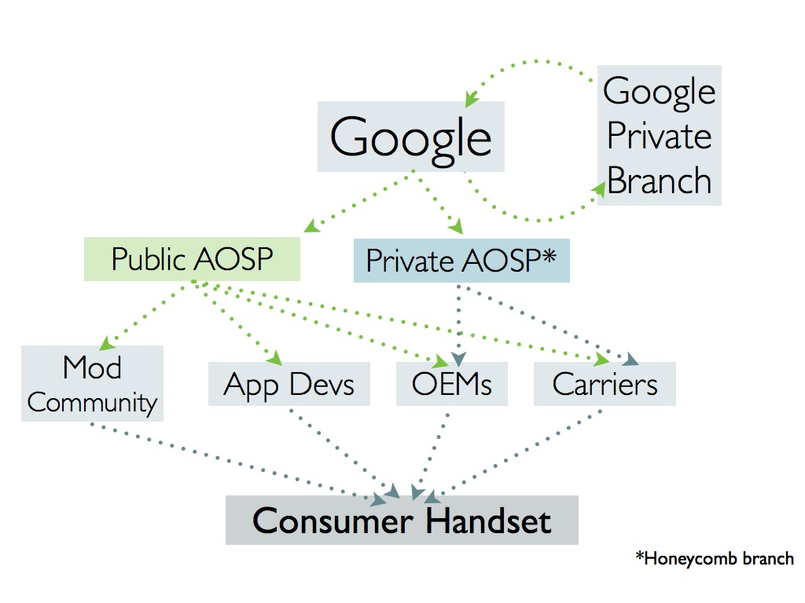
Patching: Who’s Who
https://blog.lookout.com/blog/2011/08/04/inside-the-android-security-patch-lifecycle/
Notes:
Graph from Lookout Mobile security, shows the general who-develops-what graph.
Missing some pieces about hardware fabiractors, which would fit roughly where the blue “Private AOSP” box is..
Although that box says Honeycomb is private, the source was released sometime after this graphic was made.
Hardware people make the platform
Kernel drivers, architecture support code
Google makes the base OS and Framework
OEMs change everything
Carriers complicate the situation and add bloat
Third-party OS and Applications

Slide 28
Updates
Updates for different pieces come from different places
Apps
Authors->Play Store->User
OS (via OTA)
Google->OEM->Carrier->User
Straight from Google for Nexus devices

Slide 29
Patching: AUA
Android Update Alliance
Required support for 18mo
But cellular contracts are 24mo!!!
Announced, but never mentioned again…
Who is even part of it?!

Slide 30
Patching: CTS
Android Compatibility Test Suite (CTS)
Google’s “Android Compatible” stamp of approval
Used to enforce security baselines
No known vulnerabilities
No world writable directories
etc
Continually Evolving
Tests are open source
https://blog.lookout.com/blog/2011/08/04/inside-the-android-security-patch-lifecycle/
http://blog.n0where.org/errata-to-avoiding-android-app-security-pitfa

Slide 31
Time to Patch
Google – Days or weeks
OEMs – Not enough information available
Carriers – Months or never
Notes:
Patching is still horrible despite, or maybe because of, CTS.
Would be great to see some data on this, so fingers can be pointed in the right direction ☺

Slide 32
Patching: Summary
Little-to-no back-porting fixes
Again, exploits for “half-day” bugs
Users left vulnerable indefinitely
Makes Microsoft look like Angels…

Slide 33
Disclosure

Slide 34
Disclosure
Practices vary…
Some full or coordinated disclosure
Researchers mostly
Some partial disclosure
Some non-disclosure
In general, there is very little visible security effort
Not even official bug bounties???
Notes:
No bug bounties, only Mobile Pwn2Own...

Slide 35
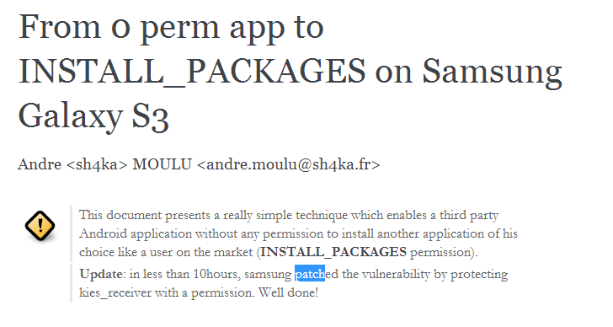
Full Disclosure
http://sh4ka.fr/android/galaxys3/from_0perm_to_INSTALL_PACKAGES_on_galaxy_S3.html
Notes:
10 Hours! WOW!!! Nice job Samsung!

Slide 36
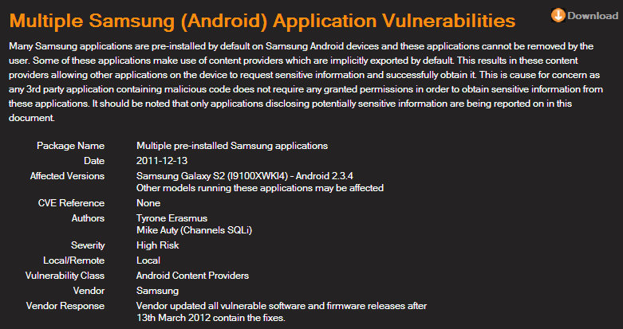
Coordinated Disclosure
http://labs.mwrinfosecurity.com/advisories/2012/09/07/multiple-samsung-android-application-vulnerabilities/
Notes:
An example of coordinated disclosure
About 3 months, not bad but could be better

Slide 37
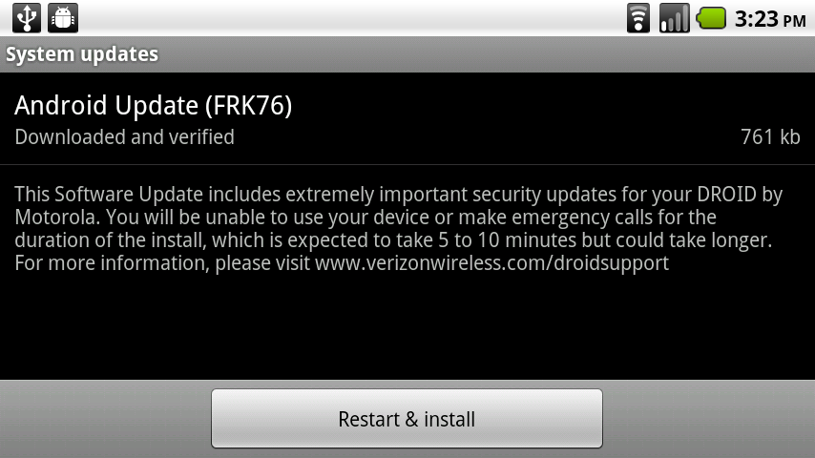
Partial Disclosure: VZW
Notes:
This is a screenshot from an old school Droid… They say there are important security fixes, but they don’t tell you what they are.

Slide 38
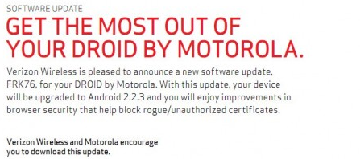
Partial Disclosure: VZW
Notes:
Here is some “more information”, but still they don’t supply CVEs. Besides, I’d hardly call this a disclosure.
The security community would really like to track this stuff in much more detail than this.

Slide 39
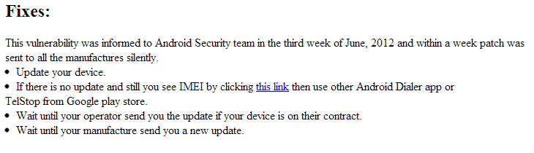
Non-disclosure?
Another example, from the recent dialer code + TEL URI issues:
“…sent…SILENTLY…” – No CVE, no disclosure
Notes:
Another example of non-disclosure…

Slide 40
Non-disclosure?
TEL URI issues
First public mention was from Ekoparty presentation
Patched prior by Samsung (on some devices)
Total timeline of only about 3 months
Not bad! … For those devices that got patched.
Notes:
Another example of non-disclosure…

Slide 41
Disclosure: Why?
Ability to track issues across organizations
CVEs help a lot here
Facilitates industry-wide peer review
Raises awareness

Slide 42
Attack Surface

Slide 43
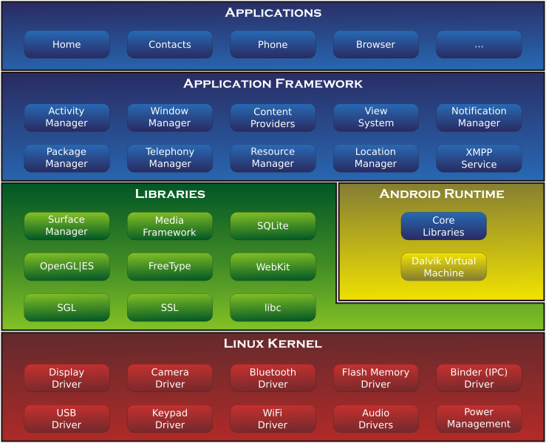
Attack Surface
Notes:
This is the most widely used architecture diagram for Android. People always use it because it shows a ton of important Android-specific stuff.
The stuff in blue is all Dalvik code, the source is in Java…
The stuff in yellow makes it possible to run the stuff in blue.
The stuff in green are libraries written in native code.
This provides the most interesting attack surface for remote memory corruptions.
It also includes the libc, called Bionic, which contains important stuff like the heap the implementation.
There are also various JNI libraries in addition to the common system libraries shown here.
The stuff in red is all kernel land. This stuff is great for escalating privileges once you get on a device.
Overall, you can see the system architecture is pretty complex.
Many operations in the system go all the way from Dalvik code, down into the kernel, and then all the way back to Dalvik code in another process.

Slide 44
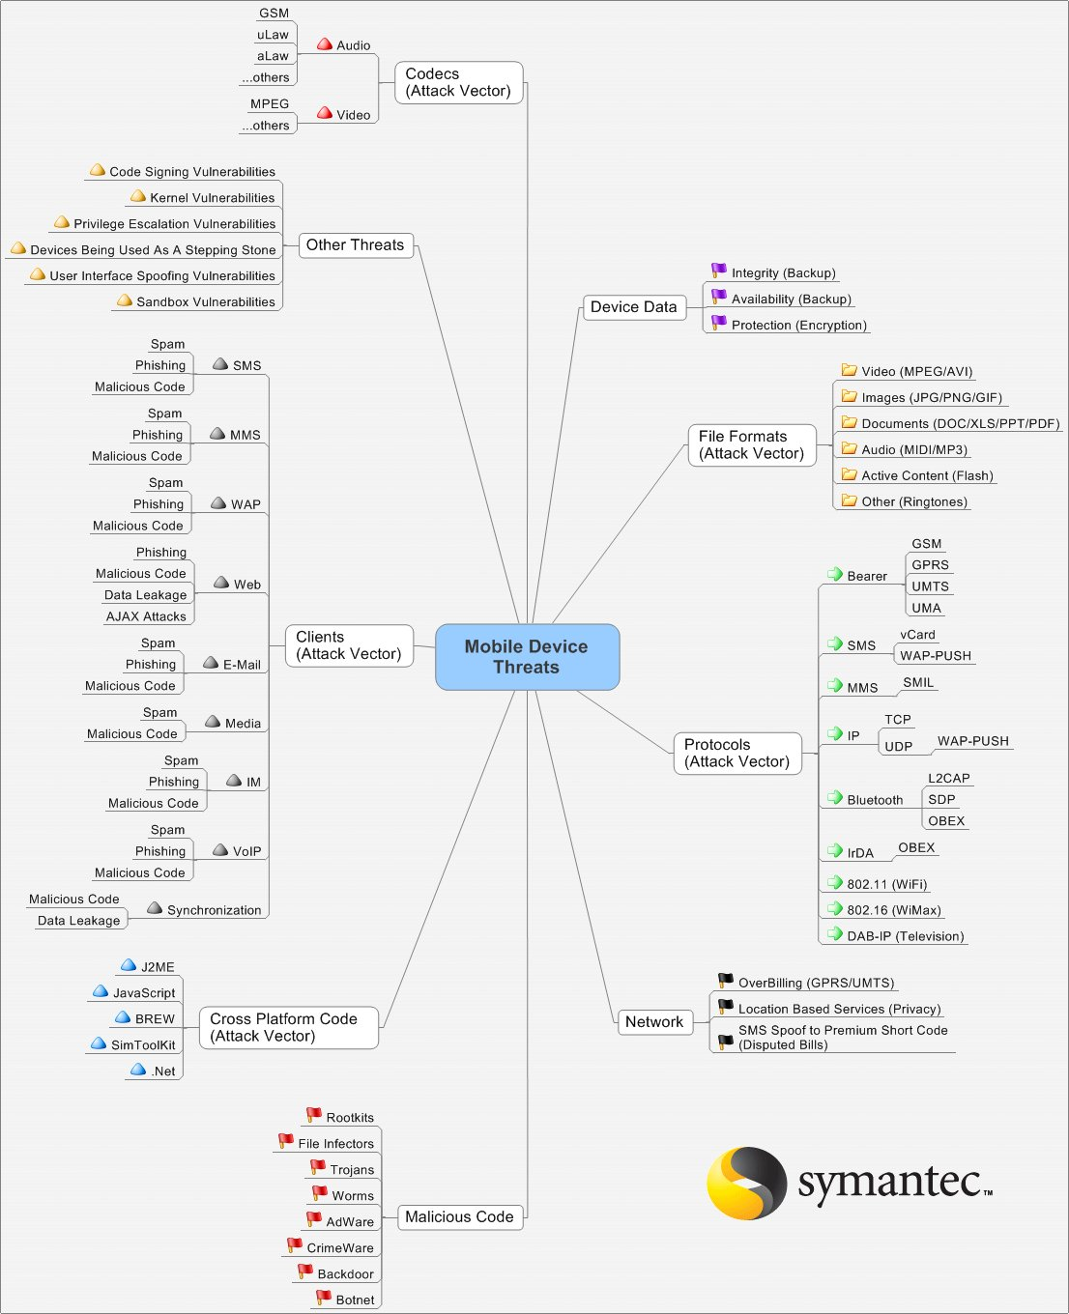
Attack Surface
http://recxltd.blogspot.com/2012/02/reflecting-on-mobile-security-today.html
http://ddanchev.blogspot.com/2007/03/complexity-and-threats-mind-mapping.html
http://www.symantec.com/connect/blogs/picture-worth-thousand-words-and-i-only-have-type-300
Notes:
I apologize if you cant see this diagram very well. Hopefully you can see it well enough to get the gist of it…

Slide 45
Attack Surface
The attack surface has grown since that diagram was created
The attack surface is HUGE
Especially “client-side” user-initiated stuff
Lots of pushing and polling going on

Slide 46
Tools

Slide 47
Custom BusyBox
Why?
Single binary
Others?
toolbox
motobox
various busybox cross-compiles

Slide 48
Custom BusyBox
Existing binaries have bugs
Issues mapping uid and gid to name
Issues mapping sockets connections
lsof
netstat
Will be working to address these issues soon

Slide 49
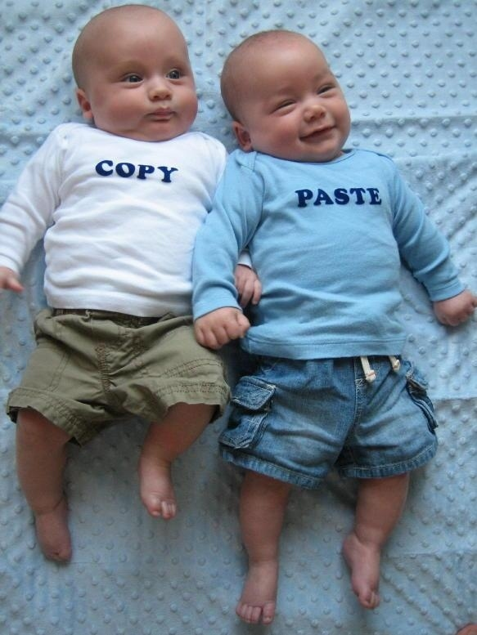
Source Code
There is A LOT of it.
AOSP
Hardcore forking action
Lots of community “ROMs”
Kernel sources by OEMs
CONFIG_MODULES=y
Can build your own modules!
“insmod” on devices!!
Notes:
Picture - http://www.blogsaays.com/wp-content/uploads/2012/04/copy-paste-material.jpg

Slide 50

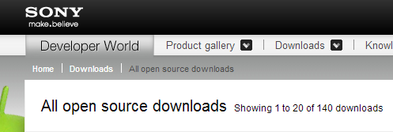
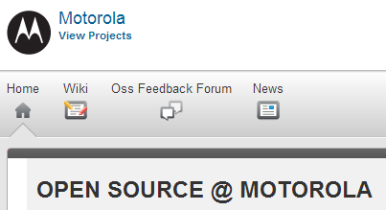
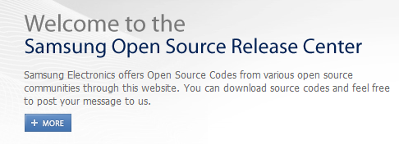

Kernel Sources
https://www.codeaurora.org/
http://developer.sonymobile.com/downloads/opensource/
http://sourceforge.net/motorola/
http://opensource.samsung.com/index.jsp
http://htcdev.com/devcenter/downloads
Notes:
There’s a lot of places to get kernel sources.
Any of these sources may have potential modifications.
Beware, these sources may or may not really be what was used to build the kernel for your device…
Consult the binaries if necessary.

Slide 51
Compilers
Many tool chains to choose from
SDK/NDK
AOSP “prebuilt”
Linaro
Official ARM compiler (RVCT)
Others?

Slide 52
Debuggers
Many different versions
Various NDK revisions
Various AOSP prebuilt binaries
Versions from Linux distros
Might have to try lots to find a working version :-/

Slide 53
Debugging: Issues
gdbserver will crash on you :-/
Need to investigate and fix these issues
Single-stepping nightmares
ARM vs Thumb insanity
x/i $pc|$cpsr.t
Symbols can tell the debugger which mode

Slide 54
Debugging: Tips
What worked for me –
Using the AOSP prebuilt debugger
arm-eabi-gdb and gdbserver
Pulling all relevant binaries from the device
Built bins with symbols from AOSP

Slide 55
Debugging: Example
ubvm:0:galaxynexus$ ls -l app_process lib*so linker
-rw------- 1 jdrake jdrake 9.7K May 6 02:21 app_process
lrwxrwxrwx 1 jdrake jdrake 26 Jun 1 23:54 libc.so -> symbols/system/lib/libc.so*
lrwxrwxrwx 1 jdrake jdrake 28 Jun 1 23:42 libdvm.so -> symbols/system/lib/libdvm.so*
lrwxrwxrwx 1 jdrake jdrake 31 Jun 26 22:19 libstdc++.so -> symbols/system/lib/libstdc++.so*
lrwxrwxrwx 1 jdrake jdrake 32 May 29 04:24 libwebcore.so -> symbols/system/lib/libwebcore.so*
-rw------- 1 jdrake jdrake 39K May 6 02:20 linker
ubvm:0:galaxynexus$ cat stuff.gdb
set solib-search-path .
set arm fallback-mode thumb
target remote 127.1:8080
[...]
set arm fallback-mode auto
cont
Notes:
This is an example of my setup for remote debugging the browser.
The important parts are telling gdb where to find the binaries that you pull off the device.
In this case I was targeting the galaxy nexus, so I was able to build versions with symbols and use those for debugging.
I did not need to put them on the device, which is nice.
Also, the “arm fallback-mode” stuff is helpful. Without the correct mode, inserting breakpoints might cause crashes.

Slide 56
Debugging: Tips
With these two things together, you can get accurate source level debugging
\o/ WIN \o/
|| ||

Slide 57
Debugging: Tips
Possible improvements
Use on-device debugger from ARM Linux distro
Requires libc, etc
Probably faster than USB

Slide 58

Exploitation
http://1.androidauthority.com/wp-content/uploads/2012/08/banner-best-army-military-soldier-games-android-120824.jpg

Slide 59
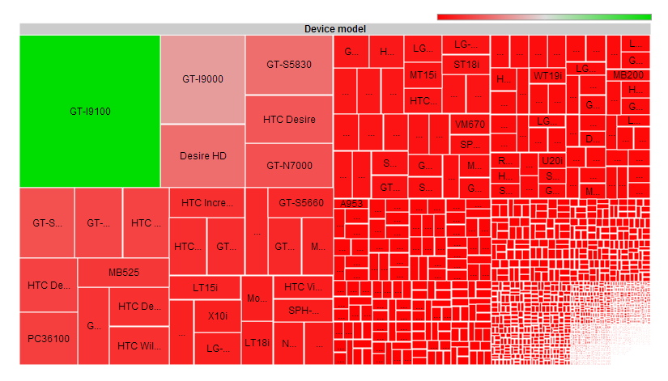
Device Pool
http://opensignal.com/reports/fragmentation.php
Notes:
The device pool is very fragmented. Because of this, developing exploits that work across a wide range of devices can be difficult or impossible.
The heterogeneous nature of the code means some vulnerabilities will only affect a subset of the device pool.

Slide 60
Exploitation
Most exploitation details are architecture specific
ARM presents some challenges
Separate data & code cache
Multiple processor modes
ARM, Thumb, Thumb2, etc
More from Stephen Ridley tomorrow!

Slide 61
Bionic Heap
Bionic (libc) uses dlmalloc
Supposedly somewhat hardened
Didn’t pose any challenge during recent exploit dev
Traditional unlink techniques should apply

Slide 62
Browser Heap
WebKit has “fastMalloc” but all memory is serviced by dlmalloc!
Includes “new” and “delete”
Crashes dereferencing 0xbbadbeef
Usually not interesting…
Out of memory

Slide 63
Dalvik ASLR Fail #1
Zygote (app_process)
Forks children, doesn’t use execve()
All Android Applications (Apps) share same initial memory layout
An info leak (from any App) is good until reboot at least, maybe longer…
The browser is an App!

Slide 64
Information Leaks
Subreption paper
“Android exploitation primers: lifting the veil on mobile oﬀensive security (Vol. I)”
Talks about using infoleaks to exploit the browser
Uses CVE-2010-4577 (Chris Rohlf’s WebKit CSS Type confusion)
Dynamic Return-oriented Programming
https://subreption.com/site_media/uploads/reports/droidleak_release.pdf

Slide 65
Hardening

Slide 66
Mitigations History
Version | Mitigation (s) Introduced
1.5 | Disabled %n format specifier
1.5 | Stack cookies (-fstack-protector)
1.5 | safe_iop
1.5 | dlmalloc enhancements
1.5 | calloc integer overflow check
2.3 | Non-executable stack
2.3 | Non-executable heap
2.3 | mmap_min_addr (enhanced in 4.1?)
2.3 | -Wformat-security -Werror=format-security
4.0 | Randomized stack
4.0 | Randomized mmap (libraries, anon mappings)
4.0.2 | Randomized heap
4.1 | Default umask changed to 077 Restricted READ_LOGS per app
4.1
4.1 | Randomized linker
4.1 | Read-only relocations (RELRO + BIND_NOW)
4.1 | Position independent executable (PIE)
4.1 | dmesg_restrict and kptr_restrict
Notes:
This is the history of various mitigation features.
I’m not going to go through these in depth, but the thing to see here is when things were introduced…
We’ll look at a couple of these a bit more..

Slide 67
Hardening: Jelly Bean
Introduced in 4.1 – Jelly Bean
Logcat output hardening
Full ASLR, finally!
Well, almost..
http://blog.n0where.org/errata-to-avoiding-android-app-security-pitfa

Slide 68
Dalvik ASLR Fail #2
diff --git a/vm/native/dalvik_system_Zygote.cpp b/vm/native/dalvik_system_Zygote.cpp
index 31fecfd..2d66cef 100644
--- a/vm/native/dalvik_system_Zygote.cpp
+++ b/vm/native/dalvik_system_Zygote.cpp
@@ -446,6 +447,12 @@ static pid_t forkAndSpecializeCommon(const u4* args, bool isSystemServer)
dvmAbort();
}
+ int current = personality(0xffffFFFF);
+ int success = personality((ADDR_NO_RANDOMIZE | current));
+ if (success == -1) {
+ LOGW("Personality switch failed. current=%d error=%d\n", current, errno);
+ }
https://android.googlesource.com/platform/dalvik/+/311886c6c6fcd3b531531f592d56caab5e2a259c%5E%21/#F0

Slide 69
Dalvik ASLR Fail #2
“personality” System Call
Linux-specific
ADDR_NO_RANDOMIZE
Also other settings like READ_IMPLIES_EXEC

Slide 70
Dalvik ASLR Fail #2
What does this mean?
Child processes don’t get randomized at all
No stack
No heap
No libs
No code
Nothing

Slide 71
Dalvik ASLR Fail #2
Except….
Doesn’t work across setuid executions
What good is it then?
Makes exploiting child processes of Dalvik applications TRIVIAL

Slide 72
Dalvik ASLR Fail #2
Example
Consider an app that runs command using remote input
This command has a silly buffer overflow in the handling of command line arguments
Trivial remote code execution!
But surely bugs like this don’t exist, right???

Slide 73
Hardening: Umask
Introduced in 4.1 – Jelly Bean
Umask is supposedly is 077, but not for adb…
Probably not a huge problem
dq:0:~$ adb shell
shell@android:/ $ getprop ro.build.fingerprint
google/takju/maguro:4.1.1/JRO03C/398337:user/release-keys
shell@android:/ $ umask
000
shell@android:/ $ exit
http://blog.n0where.org/errata-to-avoiding-android-app-security-pitfa
Notes:
I tried to get the umask of all processes on the device, but it unfortunately isn’t exposed via procfs.
Would need to inject a call to umask() into every process to find out…
Instead, I looked at the AOSP code.

Slide 74
Chrome for Android
Google includes mostly up-to-date WebKit in Chrome for Android
Requires 4.0+ :-/
Allows updating their WebKit via Google Play
Without OTA updates, firmwares
Without involving carriers and OEMs
https://play.google.com/store/apps/details?id=com.android.chrome

Slide 75
Chrome for Android
Chrome for Android has some “sandboxing”
Not really…
Mostly just process separation
More to do here
Probably actively being worked on…
shell@android:/ $ ps | grep chrome
u0_a67 23444 125 578828 91096 ffffffff 00000000 S com.android.chrome
u0_i8 23955 125 517628 45476 ffffffff 00000000 S com.android.chrome:sandboxed_process0
http://chrome.blogspot.com/2012/09/chrome-for-android-just-got-safer.html

Slide 76
SAFEDROID
Subreption guys working on a hardened Android build
Focused on OMAP (Galaxy Nexus, others)
Heavily modified version of PaX
Improved exploit mitigations
Replace dlmalloc with hardened jemalloc
Kernel heap hardening
http://www.subreption.com/news/darpa-cyber-fast-track-funding-for-high-assurance-mobile-computing-rd/
Notes:
Should be interesting to see the output of this!
Especially if Google, Carriers, or OEMs actually pick up the changes…

Slide 77
Conclusions

Slide 78
Conclusions
Device pool is a mess
Nobody is getting timely patches
Researching Android security is challenging!
Many tools are half broken
But the situation is getting better all the time…
Android Security is maturing

Slide 79
Recommendations
Notes:
I have recommendations for the various groups of people involved in Android…
Some of these are more of wishes than recommendations I guess, but here goes…

Slide 80
Recommendations
Users
Use Nexus™ devices if possible
Pure google, faster updates
Always use the latest version
Use Chrome for Android!
Buy devices up-front
Don’t sign up for 2 year contracts
Send a message to carriers!

Slide 81
Recommendations
Carriers
Stop bloating things!
Support devices at least as long as the contract!!!
Get updates to users faster
Possibly an opt-in beta program?
Be more transparent (think disclosures)

Slide 82
Recommendations
OEMs
Release more security updates
Release security fixes faster
Offer updates outside of carriers?
Be more transparent (think disclosures)
Stop making so many changes!

Slide 83
Recommendations
Google
Continue improving security (CTS ftw)
Release more security updates!
Be more transparent (think disclosures)
More devices!
Especially with a qwerty keyboard ☺
Oh, and send me some Goggles! ;-)

Slide 84

QUESTIONS?
Contact information:
@jduck1337
“jduck” on IRC
Email: jdrake [circled-a] accuvant.com
Keep an eye on my github ;-)

Slide 85
Bonus Slides
Notes:
I have recommendations for the various groups of people involved in Android…
Some of these are more of wishes than recommendations I guess, but here goes…

Slide 86
Dalvik ASLR Fail #2
commit 311886c6c6fcd3b531531f592d56caab5e2a259c
Author: Selim Gurun <sgurun@google.com>
Date: Fri Jan 13 10:47:15 2012 -0800
Prevent memory fragmentation.
Bug: 5817320
Prevent memory fragmentation and potential allocation failures. This
change is temporary.
Change-Id: Id1e8f9606687648235ea9e18861125a8c799d812
…
https://android.googlesource.com/platform/dalvik/+/311886c6c6fcd3b531531f592d56caab5e2a259c%5E%21/#F0

Slide 87
Hardening: Umask
commit 6ebf12fe1bc2de7af4522349973e8bfcc71d6126
Author: Nick Kralevich <nnk@google.com>
Date: Mon Mar 26 09:09:11 2012 -0700
init: Change umask of forked processes to 077
[…]
ueventd: Keep umask at 000. uevent needs to be able to
create device nodes with exactly the permissions it
indicates.
[…]
commit eb68fa8153d97f5f8b6d9062fcf91fe393e3bff3
Author: Nick Kralevich <nnk@google.com>
Date: Mon Apr 2 13:00:35 2012 -0700
adb: set umask to 000
Notes:
Looking at AOSP, I found that the changes happened in Android’s “init” code.
“init” is the first process in the system, started by the kernel, so these changes affect all procesess.
“ueventd” and “adbd” were both modified to set their umask back to zero.
The commit logs say these processes need to be able to create files with explicit permissions.
I would think that would be possible regardless of umask, but I’m not intimately familiar with the code…
Regardless, it would probably would require more changes that way, which takes more effort, more testing, etc

